Slide 1
FINAL PROJECT PRESENTATION • AY 2026–2027
FixMyCampus
Facility Defect and Maintenance Reporting System
BS Information Technology • BSIT2-01 • Group 4

Slide 2
01 • PROJECT TEAM
Group Composition
MANZON, JOSH MATTHEW
CERNA, MARK DYVIE
ROBOSA, RENDIL
Project Manager
Lead Developer • DevOps
Developer • QA
VIRAY, KEITH TRAVIS
YANGAO, RUBELINDA
UI/UX Designer
Documentation

Slide 3

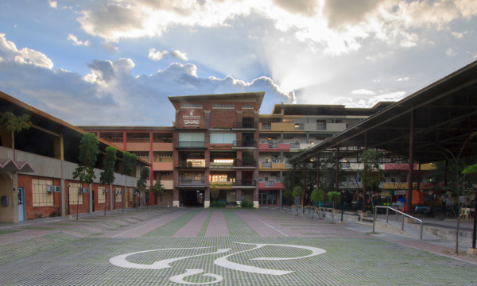
02 • TARGET SECTOR
PHINMA University of Pangasinan
Campus Facilities Management
A web-based system for reporting facility issues and coordinating campus repairs.
Scope: Facility reporting and repair tracking.
Users: Students, faculty, admins, and maintenance staff.
Goal: Clear records and visible repair progress.

Slide 4


03 • PROBLEM STATEMENT
Campus Maintenance Challenges
Project assumptions to validate with PHINMA UPang personnel.
Scattered Issue Reports
Repeated Issue Reports
Reports may be spread across different channels.
The same defect may be reported more than once.
Incomplete Locations
Unclear Repair Progress
Missing room details can delay repair work.
Users may not know who is handling a repair.

Slide 5
04 • SYSTEM OVERVIEW
FixMyCampus
Report facility issues. Assign repairs. Track progress.
Report
Track
Manage
Photos & Campus Locations
Status Updates & Notifications
Assignments & Summary Reports

Slide 6
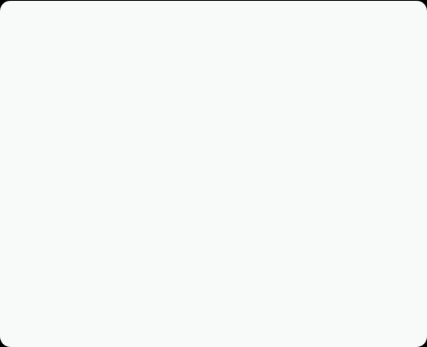
05 • SYSTEM CAPABILITIES
Core System Features
Issue Reporting: Submit photos, categories, and campus locations.
Duplicate Checks: Confirm an existing report for the same issue.
Work Assignment: Admins assign tickets to maintenance personnel.
Progress Tracking: View status updates, notifications, and history.
Dashboards & Reports: Search, filter, and export repair summaries.

Slide 7
06 • USER ACCESS
System Users & Roles
Administrator
Maintenance Staff
Student
User Management: Manage accounts and role permissions.
Assigned Work: View tickets assigned for repair.
Issue Submission: Add defect photos and location details.
Work Assignment: Review issues and assign repair staff.
Progress Updates: Add work notes and change ticket status.
Duplicate Checks: Confirm an existing campus issue.
Campus Oversight: Maintain locations and review reports.
Work Monitoring: Review assigned tasks and repair progress.
Report Tracking: Follow status updates and notifications.

Slide 8
07 • PROJECT WALKTHROUGH
From Issue Report to Resolution
01
02
03
04
Submit Issue
Review & Assign
Update Progress
Resolve & Track
Add a photo, category, and campus location.
Admin reviews the issue and assigns maintenance staff.
Staff updates repair status and adds work notes.
Record resolution and retain the report history.
Main workflow shown; reports may also be placed on hold or rejected.

Slide 9
08 • TECHNICAL STACK
Development Tools Used
System Layer | Technologies Used | Primary Role
Frontend | React, Vite, JavaScript, HTML5, CSS3 | Interactive web interface
UI & Exports | Lucide React, SheetJS (xlsx), file-saver | Icons and spreadsheet exports
Backend | PHP 8.3, Apache | REST API and database access
Database | MySQL 8.0, phpMyAdmin | Relational storage and administration
Development Tools | Docker, Node.js, Git | Local services, builds, and version control

Slide 10
09 • PROJECT RETROSPECTIVE
Challenges & Lessons Learned
Challenges Encountered
Lessons Learned
API Integration: Connecting the React interface to PHP endpoints.
Consistent Setup: Docker Compose helps reduce setup differences.
Docker Networking: Connecting the app and MySQL services.
Version Control: Small Git changes make review and merging easier.
Responsive Layouts: Keeping pages usable across screen sizes.
API Design: Clear request and response formats simplify integration.
Export Formatting: Organizing spreadsheet data with SheetJS.
Team Coordination: Clear roles and shared checks improve consistency.

Slide 11



10 • NEXT STEPS
Priorities Before Campus Rollout
Complete Integration
Strengthen Access
Run a Campus Pilot
Align the schema; connect completion records, photos, and feedback.
Enforce API permissions and remove development account fallbacks.
Test with campus users; measure usability and repair response times.
Campus acceptance and production readiness still require validation.

Slide 12
THANK YOU FOR YOUR TIME
Any Questions?
FixMyCampus — Facility Defect and Maintenance Reporting System
Repository: github.com/snybun/fixmycampus

